Slide 1
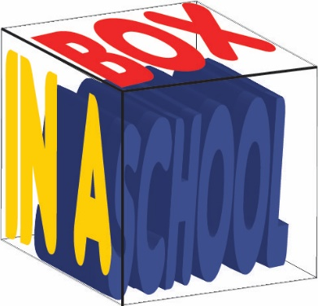
INFORMATION AND COMMUNICATION TECHNOLOGY– iGCSE
2018 - 0417
2 – Input and Output Devices

Slide 2
Assignment Scenario
There are 4 sections to this Theory Unit, each of which will give you a basic understanding and practice at possible exam questions. It will involve gaining knowledge towards the answers.
This is not a wrote learning course, you will need to understand the basics of ICT in order to adapt your knowledge towards companies and their needs. This will involve understanding Components of computer systems, Inputs and Outputs, Storage devices and media, Data Types, The Effects of Using ICT, The Ways in which ICT is used and Systems Analysis and Design.
In the exam you will be given a scenario to answers questions from, and adapt your knowledge and use the key terms and named components to give a judgemental answer.
The exam will consist of precise questions requiring precise answers as well as theory questions that will require you to propose a possible solution with a justification.

Slide 3
2 – Assessment Objectives
2 – Input and Output Devices - Overview
In this section you will learn about:
Input Devices -
The use of each device
The advantage of each device
The disadvantage of each device
Output Devices –
The use of each device
The advantage of each device
The disadvantage of each device
Control Applications and the uses of each device.
The Hardware changes that have happened in your lifetime The new technology due to come out The way gaming and PC’s have improved How more advanced your car dashboard is. What life was like before computers came along Would you miss your technology

Slide 4
2.1 – Input Devices
2.1 – Input Devices - Keyboards
Input Devices – As the name suggests, input devices are hardware devices that allow data to be input into a computer. Many such devices exist, ranging from the more common ones such as Keyboards, through to the more specialist ones, such as Barcode Readers.
Keyboards – These are the most common input devices and are used to input text, numbers and instructions into the computer. Most use the QWERTY layout. (Top row)
Activity 1 – Research other layouts like French and explain why they are laid out in this way)
Activity 2 - What is the longest English work you can made with the top row keys only.
Ergonomic Keyboards are a new thing. They are designed to reduce health related issues associated with the standard keyboard (e.g. Carpal Tunnel Syndrome or repetitive strain injury RSI)
102 keys plus shortcuts +shift options. All the keyboard shortcuts you know already. How a laptop keyboard is the same but smaller. The keypad on the right hand side, who uses it. Look at ergonomic keyboards and see if you think you could use them. What alternative could you use.

Slide 5
2.1 – Input Devices
2.1 – Input Devices - Keyboards
Advantages – Keyboards enable fast entry of new text into a document.
They have been around for a long time and people are well practiced in their use.
It is easy to do verification checks as data is entered, as it appears on the screen immediately.
Disadvantages – User with restricted arm/wrist use can find keyboards difficult to use
Entering data using a keyboard is slow in comparison to direct data entry (Optical Character Recognition)
Keyboards are fairly large devices that take up desk space.
Activity – Research Concept Keyboards and design one for a different company, like a Bakers, Mechanics or a Pharmacy
102 keys plus shortcuts +shift options. All the keyboard shortcuts you know already. How a laptop keyboard is the same but smaller. The keypad on the right hand side, who uses it. Look at ergonomic keyboards and see if you think you could use them. What alternative could you use.

Slide 6
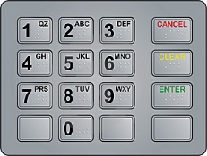
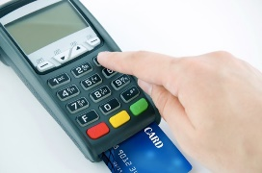
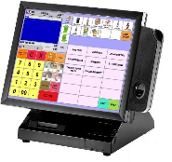
2.1 – Input Devices
2.1 – Input Devices – Numeric Keypads
A Numeric Keypad is used to enter numbers only along with the most common mathematical functions.
Uses – Numeric Keypads are used in Automatic Teller Machines (ATM’s) where customers can key in their personal identification number (PIN), an amount of money etc.
Telephones have Numeric Keypads to allow phone numbers to be entered.
Electronic Point of Sales (EPOS) terminals have Numeric Keypads in case the barcode reader fails to read and the number has to be typed in manually.
Chip and PIN devices have Numeric Keypads for PIN entry, amount of money etc.
They are used by accountants to fast entry the input of numbers into spreadsheets and ledgers.
Advantages – Numeric Keypads are faster than standard keyboards for entry of numeric data
Since many are on small devices (mobile phones, PIN readers etc.) they are very easy to carry around.
Disadvantages – They can be difficult to use since they have small keys.
It is difficult to use them for entering text.
Sometimes the order of the numbers on the keypad isn’t intuitive.
102 keys plus shortcuts +shift options. All the keyboard shortcuts you know already. How a laptop keyboard is the same but smaller. The keypad on the right hand side, who uses it. Look at ergonomic keyboards and see if you think you could use them. What alternative could you use.

Slide 7
2.1 – Input Devices
2.1 – Input Devices – Mouse
The Mouse is an example of a pointing device. A ball or laser light is used underneath the mouse to detect movement so the user can control the position of the cursor by moving it.
There are usually 2 buttons which have different functions: very often left button is used to select something and the right button to open up an options dialog box.
Most packages use double click to select areas or triple click to select a larger area.
Many mice also have a scroll button or wheel which speeds up the process of moving or scrolling through a document.
Recent developments have produced the optical mouse (where movement is detected by reflected light) and the cordless mouse (an example of a wireless device). The advantage of an optical mouse is that it has no moving parts and does not pick up dirt making it more robust and improves its performance since the older mice could skid on certain surfaces.
Before a mouse there was a tracker ball, what is it. Look at how hard core gamers use their mice. Can you use a touch screen faster than a mouse. New 3D programs use pinch and 3D rotate, could a mouse do this. Could you design an alternative mouse. When Apple Mice had one button..

Slide 8
2.1 – Input Devices
2.1 – Input Devices – Mouse
Uses – Mice can be used for opening, closing and minimizing applications.
They can be used for grouping, moving and deleting files.
They are very useful when editing images, for example controlling the size and position of a drawing pasted into a document.
Mice are used to control the position of a cursor on the screen to allow the selection from a menu or selecting an icon.
Advantages – It can be faster to select an option using a mouse than with a keyboard,
Mice enable rapid navigation through applications and the internet.
Mice are small and take up little area.
Disadvantages – people with restricted hand/wrist movement can find it hard to operate a mouse.
Mice are easily damaged and the older ones can get clogged up with dirt.
They are difficult to use if there is no flat surface readily available.
Activity – Research alternatives to mice, multi-button gaming mice and Disability friendly Mice.
Before a mouse there was a tracker ball, what is it. Look at how hard core gamers use their mice. Can you use a touch screen faster than a mouse. New 3D programs use pinch and 3D rotate, could a mouse do this. Could you design an alternative mouse. When Apple Mice had one button..

Slide 9
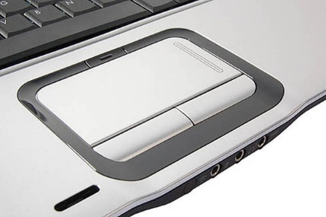
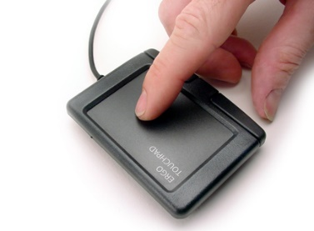
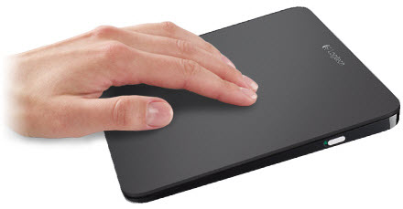
2.1 – Input Devices
2.1 – Input Devices – Touchpads
Touchpads are used in many laptops as a pointing device. The pointer is controlled by finger movement on the pad and tapping to simulate a left button mouse click. They also have buttons under at the bottom of the pad which act as left and right mouse buttons.
Uses – The same as a mouse, to move and highlight.
Advantages – Faster to select an option rather than using a mouse
Quicker navigation through applications and the Internet.
Since they are built in to a laptop, there is no need for an external mouse, aiding portability.
They can be used even when there are no flat surfaces.
Disadvantages – People with limited hand/wrist movement find touchpads difficult to use.
It can be more difficult to control a pointer compared to a mouse.
They are more difficult for certain functions like “drag and drop.”
Can use Pinch to zoom in and out. No moving parts so they do not get internally dirty. More and more common in laptops. Think of how you could add a second one to a laptop for shortcuts. Could you design an alternative touchpad. All the tech is underneath so they rarely break..

Slide 10
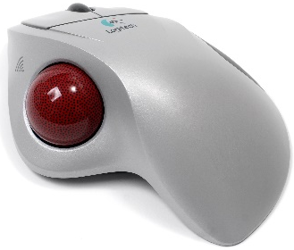
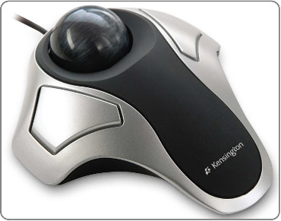
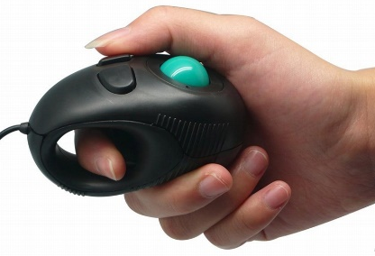
2.1 – Input Devices
2.1 – Input Devices – Trackerballs
Trackerballs are similar to a mouse except the ball is on the top of it and the user controls the pointer on the screen by rotating it with the hand. Some have 2 buttons which have the same function as a mouse. If they have a third button it is the equivalent as a double click.
Uses – They have the same pointing/cursor control as a mouse.
They are used in applications where the user has is restricted like RSI.
They are used in control room environments where it is faster than a mouse to navigate through process screens and is more robust than a mouse.
Advantages – They do not need the same fine control as a mouse.
People with limited hand/wrist movement find it easier than a mouse.
They take up less desk space than a mouse because they are stationary.
Disadvantages – They are not supplied with the computer as standard so they are more expensive.
Users may need training since they are not standard.
Cannot pinch with them Not restricted to working at a desk with some of them. Combined with tilt they are good for gaming. Means one hand has to be by the device Very similar to joystick controls Think of large surface machines and the use of Trackerballs.

Slide 11
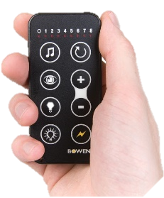
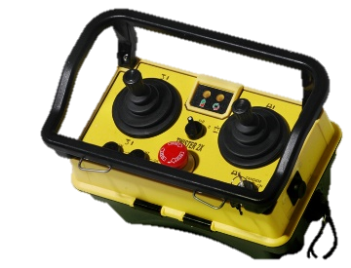
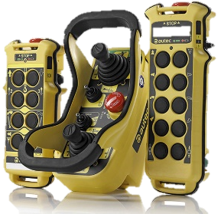
2.1 – Input Devices
2.1 – Input Devices – Remote Controls
A Remote Control is used to control the operation of other devices remotely by using infra red signals. The buttons are used to select options (such as TV stations, sound levels on a hifi, timings on a DVD recorder etc.)
Uses – Most home entertainment devices such as a TV, Satellite and DVD, Hifi etc. all have remotes.
They are used in industrial applications to remotely control processes, stop and start machinery etc.
Advantages – They can operate devices from a distance, which is useful for people with disabilities.
Some hazardous chemical processes need remote to operate from a distance because of the danger.
Disadvantages – People with limited hand/wrist movement can find them hard to use.
The signal between the remote and the device can be easily blocked.
Difficult to play TV games with Requires batteries Can easily get lost down the back of the sofa. Notice that industrial ones are all yellow. Why? Is there an App for that? After a while the buttons wear down. Count how many remotes do you have in your sitting room.

Slide 12
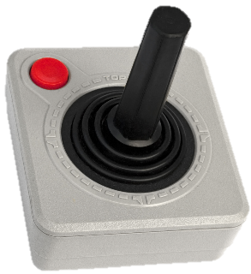
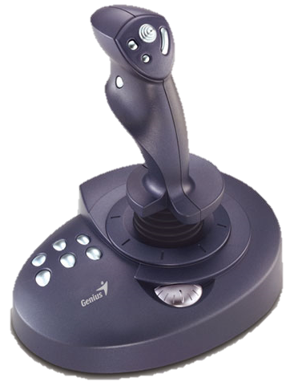
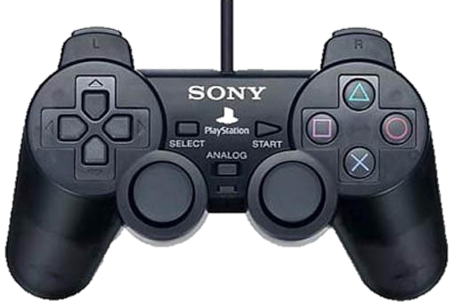
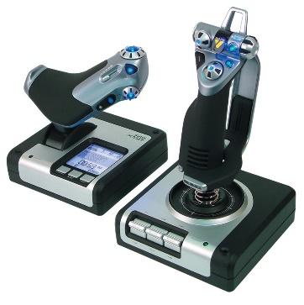
2.1 – Input Devices
2.1 – Input Devices – Joysticks
Joysticks have similar functionality to mice and Trackerballs. By gripping the stick, a pointer on the screen can be controlled and buttons are used to make selections. Often they have another button on the top that is used for gaming purposes e.g. to fire a weapon.
Uses – Video/Computer Gaming are usually controlled by a joystick
They are used for simulators, such as flight, to mimic actual controls.
Advantages – It is easier to navigate around a screen using a joystick than a keyboard.
Control is in 3 dimensions.
Disadvantages – It is more difficult to control the on-screen pointer with a joystick than with other devices such as a mouse.
Useful for flight controls Has a full 360 degree tilt and swivel. Can be removed from the desk. Difference between left and right handed. Otften used with secondary device or stick. Use of Yaw, Pitch and Roll.

Slide 13
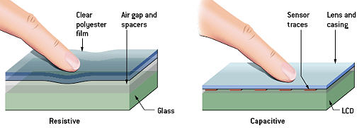
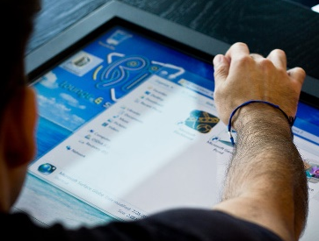
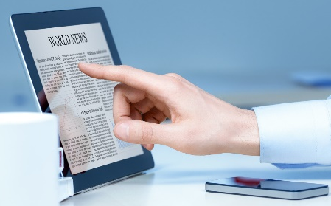
2.1 – Input Devices
2.1 – Input Devices – Touch Screens
Touch Screens – With this the user can choose an option by simply touching the button/icon on the screen. The selection is automatically made without the need for any pointing device.
Uses – Used for Self-Service tills e.g. ATM’s, Supermarkets, EPOS, Airports or petrol stations, where the user just touches the screen to make a choice like fuel and payment method.
PDA’s, Smart phones, and Sat-Navs.
Interactive whiteboards are large touch screens.
Computer based training (CBT) where touch screens are used to select answers.
Advantages – Faster entry of options than a keyboard or mouse.
User friendly and no training necessary.
Tamper proof to prevent keying in information that is not wanted, e.g. unmanned ticket booths.
Disadvantages – There is a limited number of options available.
Using them frequently can lead to RSI and muscle strain.
They get dirty easily from constant touching.
Can use Pinch to zoom in and out. No moving parts so they do not get internally dirty. More common in modern devices. Technology is getting better. Sensitivity can be changed for disability access. All the tech is underneath so they rarely break. The bigger they are, the more delicate they are.

Slide 14
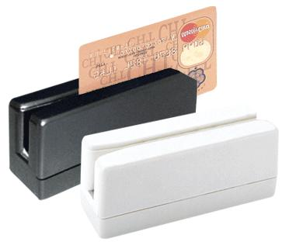
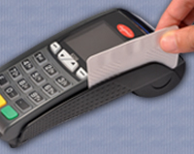
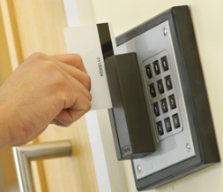
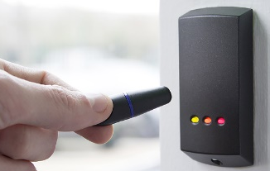
2.1 – Input Devices
2.1 – Input Devices – Magnetic Strip Readers
Magnetic Readers are used to read information on the Magnetic Stripe such as the back of a credit card. Credit card strips can contain information such as account numbers, sort codes, expiry dates and start date.
Uses – Credit and debit cards have these so they can be used in ATM’s or EFTPOS.
Security cards for entry to buildings and hotel rooms or Travel systems (e.g. train and underground tickets.
Advantages – Data entry is very fast compared to keying in information.
The system is error free as no typing is required and secure because it cannot be read directly and there is nothing to observe.
They can prevent access to restricted areas.
They are robust as they have no moving parts and are not affect by oil, water or moisture
Disadvantages – They are affected by a string magnetic field or over use, data can be lost.
Needs to be in contact with the reader.
Information is not printed on the card so a human cannot read it.
Sometimes called a Fob. Cards can be cloned using specialist devices. More secure facilities combine these with retina scans. Can be read through other cards. Often used by staff to scrape icy windows. Technology has been around for some time.

Slide 15
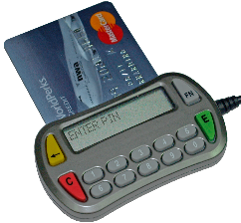
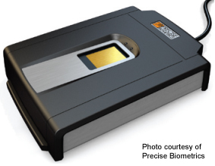
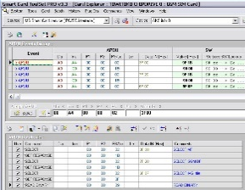
2.1 – Input Devices
2.1 – Input Devices – Smart Card Readers
Smart Cards contain chips and are similar to magnetic strips cards. With these cards the information is stored on the chip such as PIN and personal data. This data can be updated (e.g. loyalty cards) such as Oil companies use these, when a customer buys fuel the card is swiped and loyalty points added. These points can be used for air miles, money off purchases etc. The storage capacity is greater than a stripe so more can be stored.
Uses – Loyalty cards, ID cards, and public transport passes.
Used to track customer or passenger movement including passports.
Used by satellite systems to decode program signals.
Advantages – Often used instead of money (Oyster) reducing theft and loss.
Does not need to be in contact with the reader so there is less damage compared to a magnetic stripe.
Data is more secure since it is easier to copy information since cloning does not work as well with chips.
Disadvantages – If the card is lost, the information could be used for identity theft.
Can still be cloned using specific technologies.
Tap and Go technology All credit cards have this now. Similar to RFID and can be tracked. Can store previous purchases to customise EPOS offers. Small enough to store on wallets. Rarely break but can get dirty easily.

Slide 16
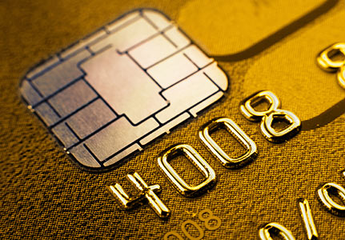
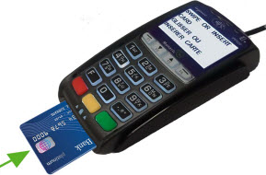
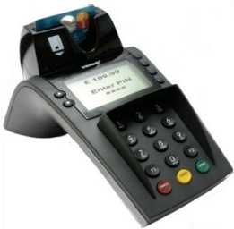
2.1 – Input Devices
2.1 – Input Devices – Chip and Pin Readers
Chip and Pin Readers are similar to smart card readers but they are used at EFTPOS terminals. The device has a slot for the card and the chip is read. The pin is entered using the keypad. A small screen is part of the reader which gives instructions to the user.
Uses – Used where payments are made using cards (cafes, supermarkets, travel agents etc.)
Advantages – They provide a more secure payment system than requiring a signature or using a magnetic stripe since the typed PIN must match the Pin stored on the chip.
They are more robust than magnetic stripe readers since the chip does not need to be in contact with the reader.
Disadvantages – Since the customer types in the pin, they need to make sure no-one else reads it opening it up for fraud.
Fast, easy and reliable. No moving parts so they do not get internally dirty. More and more common in shops and cafes. New phone apps are being developed to act as a reader. Would you trust your phone to act as your credit card. Can sometimes fall out of a credit card.

Slide 17
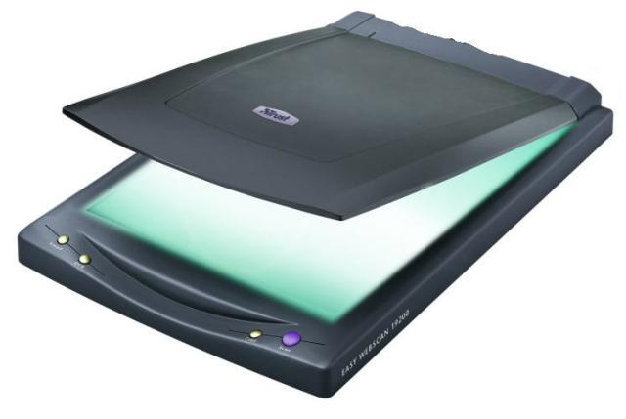
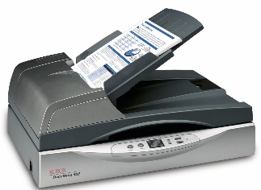
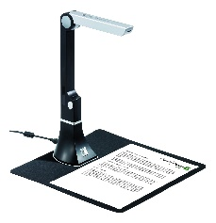
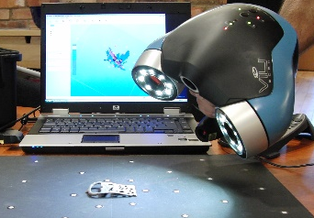
2.1 – Input Devices
2.1 – Input Devices – Scanners
Scanner are used to enter information on hard copy (text documents, photographs, pages of a book) into a computer for manipulation. The common type is flat bed which is made up of a glass panel and lid. The hard copy document is scanned by a light source and produces a computer readable image for manipulation using a drawing package, or OCR (Optical Character Recognition) so it can be placed in a word processing, DTP or Presentation package. Some scanners are more specific like a barcode or optical mark reader.
Uses – Used to scan in documents and covert them to a usable format.
Old and valuable books can be scanned, thus protecting the originals from damage or producing records of paper copies.
Non-digital photographs need to be scanned if they are to be stored on computer.
Advantages – Images can be stored for editing.
Much faster and more accurate, no typing errors, than typing.
It is possible to recover lost documents and photos by scanning them.
Disadvantages – The quality can be limited, depending on the scanner and will never be as good as the original quality.
Used to be a common desktop piece of hardware everyone had There is an App for that. 3D scanners are becoming more popular. Think of how a 3D scanner and 3D printer could be combined. Document scanners can do 100 pages or more at a time.

Slide 18
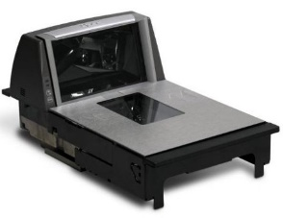
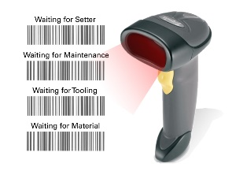
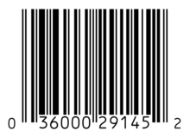
2.1 – Input Devices
2.1 – Input Devices – Barcode Readers
Barcode Readers are used to read information in the form of bar codes. The reader is usually a scanner, handheld or EPOS mounted, like supermarkets. Handheld scanners or wands are very common when portability is required.
Uses – They are used in supermarkets and shops where the goods are marked with a barcode and used to give limited information about the product to enable sales or stock control, itemised billing etc.
Used in libraries to scan cards and books, to keep track on loans.
Used by companies as a safety feature to ensure electrical checking (PAT) on a regular basis. Barcodes are placed to identify the object in a database which holds the information related for re-interrogation.
Advantages – Very fast method of and fewer mistakes are made.
Used to improve safety and enable automatic stock control.
When an item is changed, the central database updates the barcodes so there is no need to change the pricing on the item.
Disadvantages – Relatively expensive since every item in a shop needs a barcode and entered into the database. Also training and IT needed.
Not foolproof, barcodes can be swopped around ion items.
See how fast goods can be scanned What was shopping life like before barcode scanning What do those numbers mean. Would individual pricing work today. Supermarkets now have a barcode app to count your own goods. What other ways could you cheat a barcode.

Slide 19
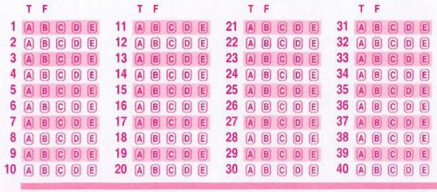
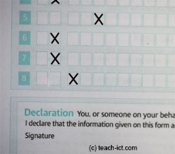
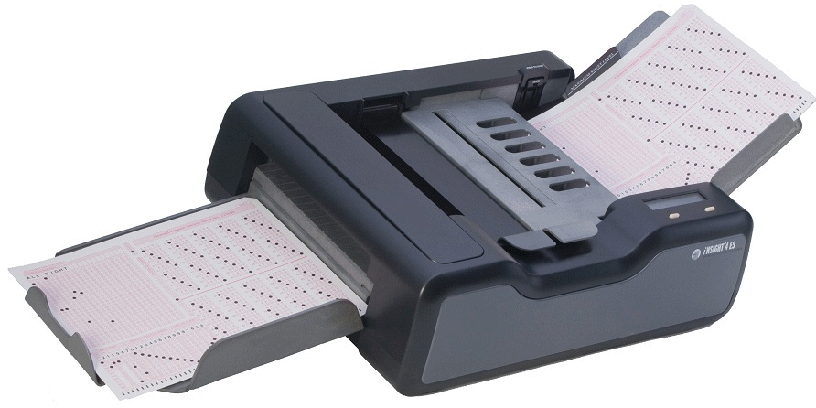
2.1 – Input Devices
2.1 – Input Devices – OMR Devices
Optical mark Readers (OMR) is a system which can read marks written in pen or pencil. The places where the marks are made are clearly shown on the form, for example: 1 -- 2   3  
In this example, a pencil mark has been made between the dots on answer 1. The position of the mark is stored in the computers memory after being read by the OMR device.
Uses – They are used to read questionnaires, multiple choice examination papers and other types of forms where responses are registered in the form of lines or shaded areas.
Advantages – It is a very fast way on inputting awkward information like survey results, the documents are fed in automatically with no user input.
No typing therefor more accurate than keying in data and more accurate than OCR.
Disadvantages – The forms need to be carefully designed to make sure that the marks and shading are correctly positioned for accuracy.
There are issues when the form is not filled in correctly and sometimes have to be manually checked before being read by the OMR which is time consuming.
How shops scan lottery tickets. Remember the days of the football pools and Littlewoods. Research Hanging Chads and George Bush. Some School registers are still done in a similar way. What if the questions are not just Yes/No. How light can the mark be.

Slide 20
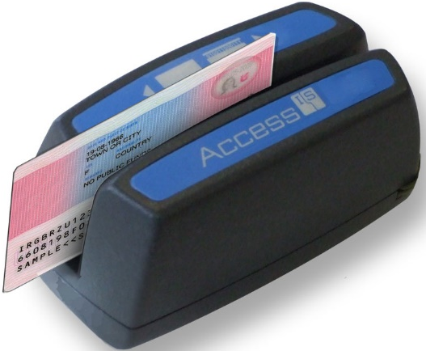
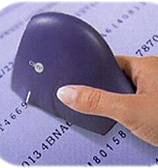
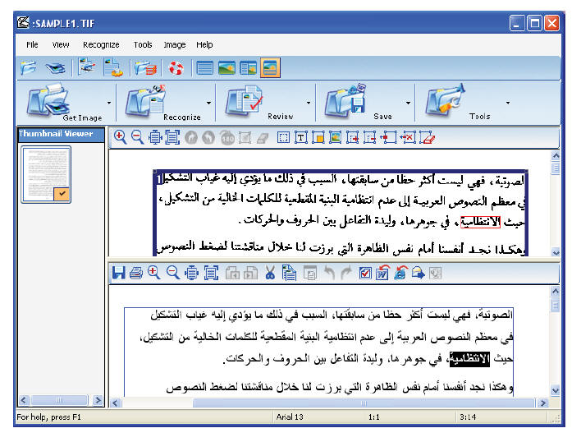
2.1 – Input Devices
2.1 – Input Devices – OCR Readers
Optical Character Recognition (OCR) is the name given to software that takes scanned text and converts it into a computer readable form to be used in Word processing, DTP and presentation packages.
Uses – One of the most common uses is in Passports and Identity Cards.
OCR is used when scanning in documents so they can be modified.
Advantages – It is a much faster data entry system than manually keying in data
Since there is no manual data entry, the number of errors is reduced.
Disadvantages – The system has difficulty reading handwriting.
It is still not very accurate and requires post processing (Spellchecking and grammar checking)
Look at Google scanning old books for Google library. Thousands of files kept by companies before computers were around. Old manuscripts that can only be read under special observation. The time it would take to retype a book Will E-books replace printed books

Slide 21
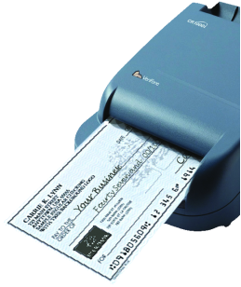
2.1 – Input Devices
2.1 – Input Devices – MICR Devices
Magnetic Ink Character Recognition (MICR) is a system which can read characters printed in a special ink (containing iron particles). Only certain characters written in a standard font can be read like the characters at the bottom of a check. These are then converted into a form that the computer can understand and stored in a computer file.
Uses – It is primarily used to process checks in banks. When a check is presented its value is then printed on the check in special ink. The checks are all gathered together at the end of the day or period and then read using a batch processing method.
Advantages – MICR offers greater security than OCR since the printed characters cannot be altered.
There is no manual input therefor errors are reduced.
Even if someone writes over the magnetic strip, they can still be read.
Disadvantages – Only certain characters can be read and the number of characters is limited.
It is a more expensive method than other methods used in direct data entry.
Companies process salary checks for all staff at the end of the month. Think of the money counting machines, it is the same as MICR Anything that saves a company money is worth doing. As long as the computer knows, then the numbers are unreadable by a human. Could there be an app for this.

Slide 22
2.1 – Input Devices
2.1 – Input Devices – Digital Cameras
Digital Cameras have generally replaced traditional film based cameras. Once photos are stored in memory they are easily transferred to a computer using a USB cable. Once saved the images can be manipulated.
Uses – Digital cameras produce photos directly to a computer or onto a card for printing.
Most cameras also record videos.
Photos can be updated directly into packages like Presentation or Art.
Advantages – it is easier to upload and produce better quality photos than with a traditional camera or through scanning.
No need to process and dark room develop the images saving money and the environment.
It is easy to delete an image from memory and take it again.
Memory cards can store thousands of images whereas film was limited to 24 or 36.
Disadvantages – The user needs to be computer literate for using the camera and for transferring the files.
Some artistry is lost in the process since software corrects flaws like red-eye.
Quality though good is still not as good as a traditional cameras (it’s all about pixels)
It is possible to fill the computer quickly or be forced to compress the images.
Do you have one at home. Do you consider your smart phone is a quality camera. How many old cameras do you have. Why do some people still have those large ones. Could you do a photography course without using Photoshop Is losing the art of photography a bad thing.

Slide 23
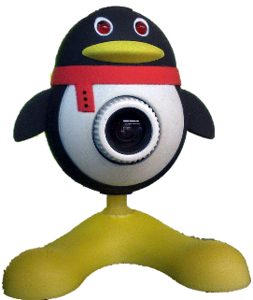
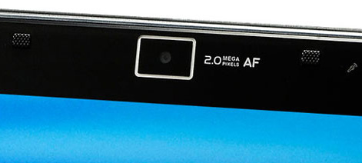
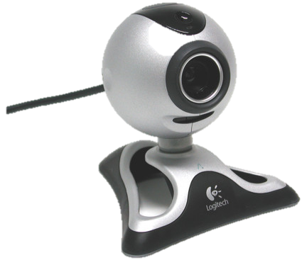
2.1 – Input Devices
2.1 – Input Devices – Webcams
Webcams are and do not have a memory. to digital video cameras; however they are connected directly to the computer (USB). The information the webcam sees is transmitted live to the computer. Many computers now have them built into the monitor.
Uses – When chatting online, many people use a webcam as a more personal way of conversing.
They are used to enable video conferencing (see section 4).
Advantages – Webcams can be left on constantly and activated when necessary.
They allow people to keep in contact with each other over long, non travelled distances making them useful to the elderly and disabled.
Disadvantages – They have limited features and the picture is often poor quality.
They need to be connected to the computer, (except most laptops)
Mobile phones have them but people rarely use them, why? No moving parts so they do not get internally dirty. More and more common in laptops. How they have been hacked. Integrating it with 3D or VR. How often do you check if the light is on as children often leave them running.

Slide 24
2.1 – Input Devices
2.1 – Input Devices – Microphones
Microphones can be connected directly to the computer. Sounds can be inputted and then manipulated. The input sound is converted to an analogue signal and then converted to a digital signal. The computers sound card does this automatically (ADC).
Uses – They are used to input speech/sounds to be used in various applications e.g. presentations, film and music sampling, special effects.
They are used in voice recognition software which have a number of purposes:
Conversion of speech into text for use in a word processor.
Recognition of commands like voice activated cars or Siri.
Advantages – It is faster to read in text than to type it with a keyboard.
Using specialist manipulation software it is possible to edit sounds in real time instead of using live studio techniques.
If used in voice activation then it is more secure than passwords also reducing the need for drivers to remove their hands from steering.
Disadvantages – Sound files take up computer space and memory.
Voice recognition software is not as accurate as typing manually (think of words like there and their and they’re)
How you could use a voice dictation program. Voice quality on cheap mics when skyping. How they are integrated to laptops but not PC’s. The people who talk to the earphone cable in the street. How your earphones are also microphones if you plug them into the other socket.

Slide 25
2.1 – Input Devices
2.1 – Input Devices – Sensors
Sensors (analog) is a device which inputs data to a computer where the data is a measurement of some physical quantity which is always changing e.g. temperature, light, moisture, movement) These physical qualities are analog in nature. These will need converting into digital for the computer to understand using an ADC (Analog to digital converter)
Uses – They are used in monitoring and control applications, depending on the situation. When monitoring, the data sent to the computer goes to a spreadsheet and processed.
Does you car have a parking detector. The n umber of sensors in your house right now (washing machine, microwave etc.) The few nuclear accidents due to sensor or human error. How your phone has a light setting for outdoors and indoors. Shops have them to watch what the customers are buying and not buying.
Type of Sensor | Applications
Temperature | Automatic Washing machines, central heating systems, greenhouses and ovens.
Pressure | Burglar alarm systems, washing machines, robotics, environmental monitoring.
Light | Automatic greenhouses, doors, burglar alarms, street lighting control.
Sound | Burglar alarms, monitoring liquid and powder flow in pipes
Humidity / Moisture | Automatic greenhouses, environmental monitoring, factories where moisture levels are crucial like microchips or paint spraying.
pH | Automatic greenhouses, chemical processes, environmental monitoring.

Slide 26
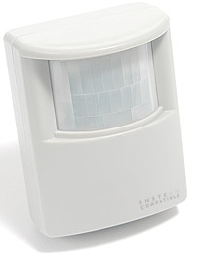
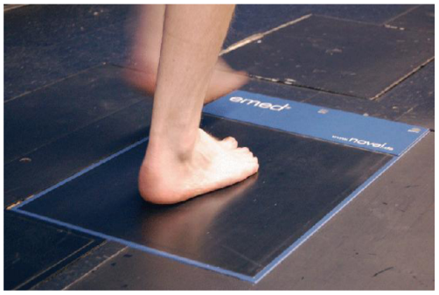
2.1 – Input Devices
2.1 – Input Devices – Sensors
Advantages – Readings taken over sensors are generally more accurate than those taken by human operators.
Readings are continuous, so there is no break in monitoring, therefor and necessary action (control systems) or warning (monitoring systems) will be initiated immediately.
The system can be automatic, removing the need for human intervention, specifically important when dealing with hazardous materials or chemicals.
Disadvantages – Faulty sensors can give erroneous responses such as rear bumper sensors on a car can get dirty and give false readings.
Does you car have a parking detector. The n umber of sensors in your house right now (washing machine, microwave etc.) The few nuclear accidents due to sensor or human error. How your phone has a light setting for outdoors and indoors. Shops have them to watch what the customers are buying and not buying.

Slide 27
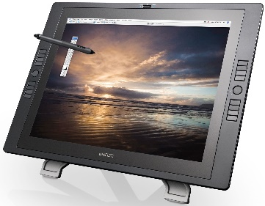
2.1 – Input Devices
2.1 – Input Devices – Graphics Tablets
A Graphics Tablet is used with a stylus to produce freehand drawing. The images produced can then be stored in a computer file or used directly on the screen.
Uses – Used to produce drawings and computer graphics and in Modelling and CAD work (Computer Aided Design).
In countries where characters are complex like China and Japan, they are used as a form of input since it is faster than typing in the characters than a keyboard.
Advantages – It is possible to modify the drawings before they are input.
They can be pressure sensitive for thicker lines of drawing.
They offer a very accurate method of drawing which is better than using a mouse of tracker ball.
Disadvantages – They are more expensive than other pointing devices.
The accuracy you have when drawing with a pencil compared to the physical movement of a mouse. No moving parts so they do not get internally dirty. They are pressure sensitive. Tablets can have programmed shortcuts as buttons on the device. 3D packages for modelling and how a stylus and tablet would help.

Slide 28
2.1 – Input Devices
2.1 – Input Devices – Light Pens
Light Pens contain sensors that send signals to a computer whenever light changes are detected. They only work on Cathode Ray Tube (CRT) monitors because of the way the screens are made. The screens are refreshed 50 times a second so the computer is able to determine the pens position buy noting exactly when the light pen detected the electron beam passing its tip. (TFT is being developed)
Uses –or drawing on screen (e.g. CAD packages)
Advantages – used for selecting objects on the CRT screens.
Also used re more accurate than touch screens die to the thin point of the pen. fThey a
They are small, pen size, so they can be used where space is an issue.
Simple to use.
Disadvantages – There are problems with lag when drawing on screen.
Only work at the moment with CRT monitors.
Accuracy is not good when drawing.
Used when there are no tablets or touch screens. Getting more rare now there are less CRT’s Think of the pens used on Smart Boards. Used in lessons as interactive. Only one pen can be used so no pinching or capacitive control. Used a lot in mechanics but being replaced.

Slide 29
2.2 – Output Devices
2.2 – Output Devices – CRT Monitors
Output devices are hardware devices those that allow data to be output. Some hold information temporarily like printers whereas others have a permanent output in the form of a hard copy.
CRT Monitors – These are the least expensive monitor and becoming more rare as TFT is taking over. They come in various sizes and use an electron gun to fire against a phosphor screen which creates a picture made up of small dots either Red, Green or Blue.
Uses – They are used as the primary output of base computers so the user can see what they are typing in.
They are used with Light Pens to allow designs to be created on screen.
Advantages – They still produce a higher quality image than TFT monitors.
The angle of viewing is still better than a TFT monitor.
They work with Light Pens in CAD/CAM applications.
Disadvantages – They tend to be heavy and often a weigh hazard.
If they are older, they run hot due to gathered dust on the metal plates.
They use more power than any other monitor type.
They can flicker, which causes headaches and eyesight problems with prolonged use.
The average 24” one can weight 6 stone. The screen is curved, TFT’s are flat, why? Are there any left in your school? All energy causes heat, feel how hot the top of the monitor is. They do not have a cable that disconnects like TFT. Desk space Footprint?

Slide 30
2.2 – Output Devices
2.2 – Output Devices – TFT Monitors
TFT Monitors – They are replacing CRT’s as the standard main output device. Laptop development is because of the advancement in the technology of TFT’s. The screen is made up of thousands of tiny pixels which are transistors controlled by a microprocessor. Each pixel has 3 transistors, Red, green and Blue, the intensity of each is what is seen.
Uses – They are the primary output device to see what is being typed.
They are an integrated part of a Laptop.
Advantages – They are lightweight so they are less risky than CRT’s
They produce less glare and emit less radiation, use less power and generate less heat.
Disadvantages – The angle of viewing is critical, the image is unclear when viewed from the side which is an issue when more than one person is looking at it.
The definition is not as good as CRT’s.
They cannot be used by light pens reducing down their CAD ability.
Why you would still prefer a TFT than a CRT Modern ones that have the computer build into the display like an iMac. Why some people have more than 1 display. Why do they hide the buttons on the right hand side. If you could project your tablet to one without cables, would you want one.

Slide 31
2.2 – Output Devices
2.2 – Output Devices – Laser Printers
Laser Printer produce very high quality hard copy output. The print rate per page is very quick for large print jobs. They have large buffer memories where the data for the whole document is stored before the data is printed out.
Uses – Laser printers are used where noise levels need to be kept low.
They are the best option for fast high quality volume printing
Advantages – Printing is fast for bulk, but not for just a few pages.
They require less servicing and ink replacement as they print a lot more pages making them more cost effective for B&W printing.
They handle very large print jobs due to high memory capacity with consistent high quality.
Disadvantages – They are more expensive to buy. Colour versions are very expensive to buy and run since they require 4 cartridges as well as diffuser kits and toner bins.
Why are there so many old looking ones in the room? Can you repair a paper jam. Does anyone ever use the built in menu. What if there was a par ton top for quick copying. Why are they always square. Did you know that the toner ink is very toxic?

Slide 32
2.2 – Output Devices
2.2 – Output Devices – Inkjet Printers
Inkjet printers are used to produce good quality hard copies, usually in colour. They are not as good as laser printers but are far better than dot matrix. They do not have large memory buffers so printing is done a bit at a time, causing the print job to pause and think and get more data.
Uses – They are used when there is low volume required or if colour is required or good quality single jobs like Photo printing.
3D inkjet printers are now being used in industry producing prototypes.
Advantages – The output is high quality and are cheaper to buy than laser printers.
They are light with a small footprint.
They do not produce ozone and volatile organic compounds unlike laser printers.
Disadvantages – The output is slow for multiple copies and they have a small memory buffer for jobs.
Ink cartridges run out quickly and can smudge if the user is not careful.
New versions have wi-fi, card slots and screens Lots of moving parts and small paper trays When one ink runs out you can replace it easily. Most people get a laser and do away with the inkjet, why? Sometimes they cost less than the printer cartridge so it is cheaper to get a new one when the ink runs out.

Slide 33
2.2 – Output Devices
2.2 – Output Devices – 3D Printers
3D Printers are anew type of printer that can produce 3D models using modified inkjet technology, known as “tomography” which layers thin levels of powder (plaster, resin and starch) which bonds together as a 3D model as the layer builds up, each layer being about 0.25mm thick.
Uses – Inkjet printers are use to produce prototypes which work from CAD packages, photograph images and stored drawings.
Scale models are produced in colour before the real versions are manufactured.
The ultimate objective is to produce organic objects using layering like human organs.
Advantages – They save a lot of money since prototypes is very time consuming by other methods.
Physical scale models are produced with working parts which gives a better idea of how the end product will look.
The powders used can be ground up and reused.
Disadvantages – They are expensive to buy and slow at making models.
The end product can be a little rough and often needs additional work.
Think of what can be produced now and then image 10 years time. They are working on food versions. They flew one to the MIR space station recently. Google the term Physibles. One day they will print a working car. Research is fast developing, human tissue is not far off, they have printed veins.

Slide 34
2.2 – Output Devices
2.2 – Output Devices – Dot Matrix Printers
Dot Matrix Printers are a type of impact printer where a print head (made up of a matrix of pins) presses against an inked ribbon. They tend to be slow, noisy and the output is not good quality. They are still useful where multi-part or continuous stationery, perforated paper is used.
Uses – They can be used in noisy environments (e.g. garage workshops) and in applications where print quality is not important.
Advantages – They are used in environments which would be a problem for Laser or Inkjet printers (dusty, dirty or moist)
Carbon copies or multi-part outputs can be produced.
They are cheap to run and maintain.
They are easy to use if continuous stationery is required like wage slips.
Disadvantages – They are very noisy and not good in an office space.
They cost more than an inkjet to buy.
They are slow and the quality is poor.
Some companies put them in a sound box Every printer was different so the ribbons were not universal. It was possible to turn the ribbon over on some. Paper jams were so much worse. They had no complicated menus, just 3 buttons. They were always white or cream.

Slide 35
2.2 – Output Devices
2.2 – Output Devices – Plotters
Plotters or Graph Plotters are devices that produce hard copies but differently than printers. They are not limited to normal paper sizes and are capable of producing highly accurate, very large drawings and posters. Pen plotters are the most common which use coloured pens to draw, and there are electrostatic (similar to laser) and inkjet plotters. With pen plotters the coloured pens are controlled by the computer and the paper can move backwards and forwards to allow accurate shapes to be drawn.
Uses – They are used to produce large blueprints of buildings, factories etc. and often used with CAD packages.
They are used for billboards and large posters and can print on plastic coated paper.
If the pens are replaced with cutting tools then they can be used as stencils or to make large signs.
Advantages – They produce large printouts and the quality is very high.
Disadvantages – They are slow and expensive to but and maintain.
Before these architects used to hand drawn large designs. Some are very large, large enough to walk under. More common now to save the file and print it professionally. Think of a large poster and then think wall size large. Very rare to see them but in business they are more common.

Slide 36
2.2 – Output Devices
2.2 – Output Devices – Speakers
Speakers can be connected directly to a computer or built into the monitor or casing like a laptop. Digital data from the computer is converted into analogue form using a Digital to Analog Converter (DAC) and then amplified through the speaker.
Uses – They output sound from multimedia presentations, home entertainment centres and downloaded sound files.
They can help blind people (together with speech generated software) to through audio output of the text on the screen.
Advantages – They are better quality externally than laptop speakers.
There have been advance in 5.1 and 7.1 technology.
Disadvantages – They take up desk space and give off a magnetic field which can corrupt cards and disks..
Have you tried to sue an external speaker on your phone or computer. With music computers these are essential when it comes to quality. There are some very large speakers. The larger they are, the more need for an amplifier. They can be customised to blend in with the furniture.

Slide 37
2.2 – Output Devices
2.2 – Output Devices – Multimedia Projectors
Multimedia projectors receive analog or digital signals, usually from a computer TV or DVD player. The image from the source is magnified and projected onto a large screen. They usually have a remote control, but a virtual mouse is becoming popular with new ones.
Uses – They are used for training presentations to show to a large audience.
They are also used for advertising presentations at exhibitions, shopping malls etc.
Home cinema systems using projected DVD’s
Advantages – They enable larger audiences than a screen or TV
Used in classes to watch videos or PPT’s rather than a network.
Disadvantages – Images are sometimes fuzzy.
They are expensive to buy and difficult to set up in terms of space.
Would you like one for the bedroom to watch TV on. Very similar technology to film projectors. There will be a device for your phone that can do the same. Research Keystone. Requires a darker room than normal to view the images. Watch almost any movie and spot them being used..

Slide 38
2.3 – Control Devices
2.3 – Control Devices – Actuators and Motors
Control Devices are another type of output device used to control processes in conjunction with sensor input devices, covered in more depth in PowerPoint 7.
Actuators are transducers are used to make signals form a computer and convert them into some form of motion, e.g. operating motors, pumps, switches and valves. As part of the process, digital signals are sent from the computer to an Actuator to operate a device. Usually, conversion of the digital signal to analogue is required first (DAC)
Motors – The motor is turned on or off by the actuator.
Uses – Used in many domestic appliances such as washing machines (to make the drum rotate), cookers (to switch on fans), water pumps in central heating systems and automatic greenhouses to open windows and switch on fans.
In industry, they are used to control robot arms.
In computers, they operate fans, disk and DVD drives.
If anything electronic turns on anything physical it will use an actuator and motor. They have been around since the beginnings of the circuit board. They can be very, very small. Artificial heart valves have these inside. It is rare for them to break down. But when they do it is a pain to fix.

Slide 39
2.3 – Control Devices
2.3 – Control Devices – Buzzers, Lights and Heaters
Buzzers are switched on and off by the actuator
Uses – Buzzers are used in cookers and microwave overs to tell the user when the cooking process is over.
They are used in burglar alarms to warn if intruders are present.
Lights – The actuator is connected to switches that turns the lights on and off.
Uses – They are used for security lighting and in greenhouses to control the lighting conditions.
Heaters – Actuators are connected to switches which turns the heater on and off.
Uses – Heaters are used in automatic washing machines, cookers and central heating systems.
Heaters are used on automatic greenhouses to control the temperature.
If anything electronic turns on anything physical it will use an actuator and motor. They have been around since the beginnings of the circuit board. They can be very, very small. Artificial heart valves have these inside. It is rare for them to break down. But when they do it is a pain to fix.

Slide 40
2 – Exam Questions
2 – Exam Questions on Input, Output and Control Systems
Buzzers are swit

